Slide 1
Neuroevolution-Enhanced Multi-Objective Optimization for Mixed-Precision Quantization
Mary Qubty , Amal Awawdi
Notes:
both

Slide 2
INTRODUCTION
The Quest for Efficiency: With the growing popularity of deep neural networks, there arises a need to optimize their performance on a variety of hardware platforms.
The desire to deploy DNN workloads on different hardware has created a need for advances in memory and compute compression techniques for DNNs.
Notes:
amal

Slide 3
NEMO
Neuroevolution-Enhanced Multi-Objective Optimization for Mixed-Precision Quantization
It delivers state-of-the-art compute speedups and memory improvements for artificial intelligence (AI) applications..
NEMO successfully trains GNN representations to find optimal mixed-precision configurations using neuroevolution.
Notes:
mary

Slide 4
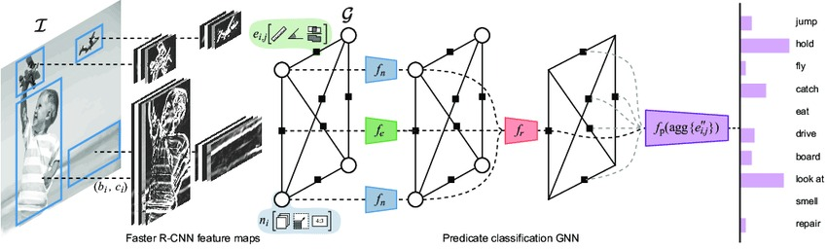
NEMO successfully trains GNN representations to find optimal mixed-precision configurations using neuroevolution.
GNN - Graph Neural Network
Notes:
amal

Slide 5
NEMO successfully trains GNN representations to find optimal mixed-precision configurations using neuroevolution.
Mixed-precision configurations in deep learning involve using different numerical precisions for representing and processing data in a neural network. By assigning lower precisions to certain components, such as using 16-bit or 8-bit numbers instead of 32-bit floating-point, memory usage and computational efficiency can be optimized, resulting in reduced memory footprint and improved throughput.
Notes:
mary

Slide 6
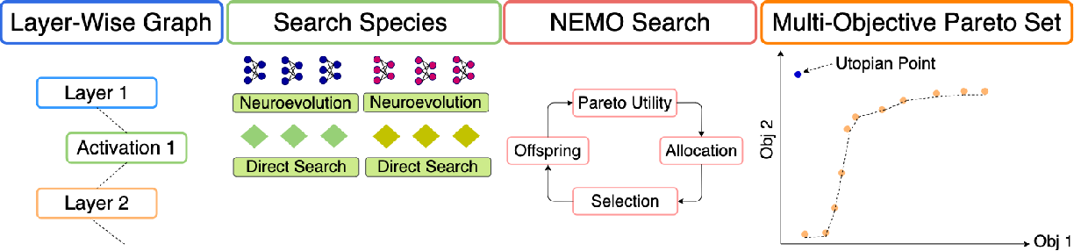
The method is based on the integration of three techniques:
Formulating layer-wise mixed-precision quantization of a workload as a multi-objective search problem enabling us to apply traditional search methods as distinct species.
Refactoring of the workload into a sequential graph representation suitable for GNNs, which we can formulate as neuroevolution species.
Finding a Pareto optimal set of solutions using NEMO leveraging traditional search and GNNs as separate species in the population.
Notes:
Amal+ mary
they can be mathematically expressed as a Pareto optimal set, also known as a Pareto frontier. Specifically, the Pareto optimal set consists of solutions where no other solution can be better in at least one objective in the optimization space.

Slide 7
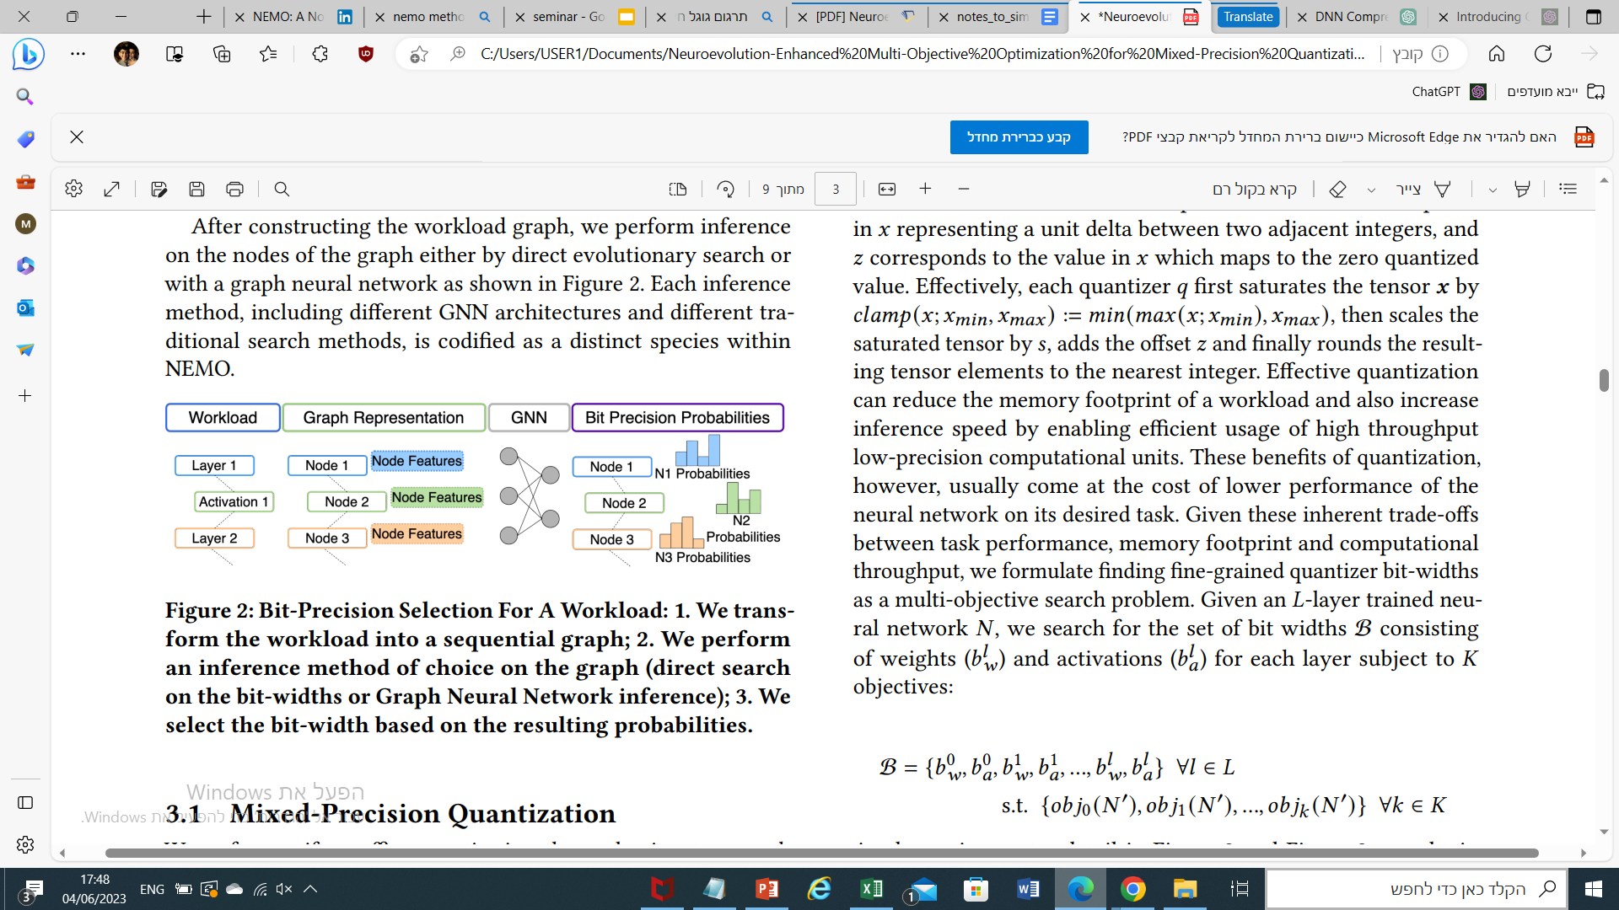
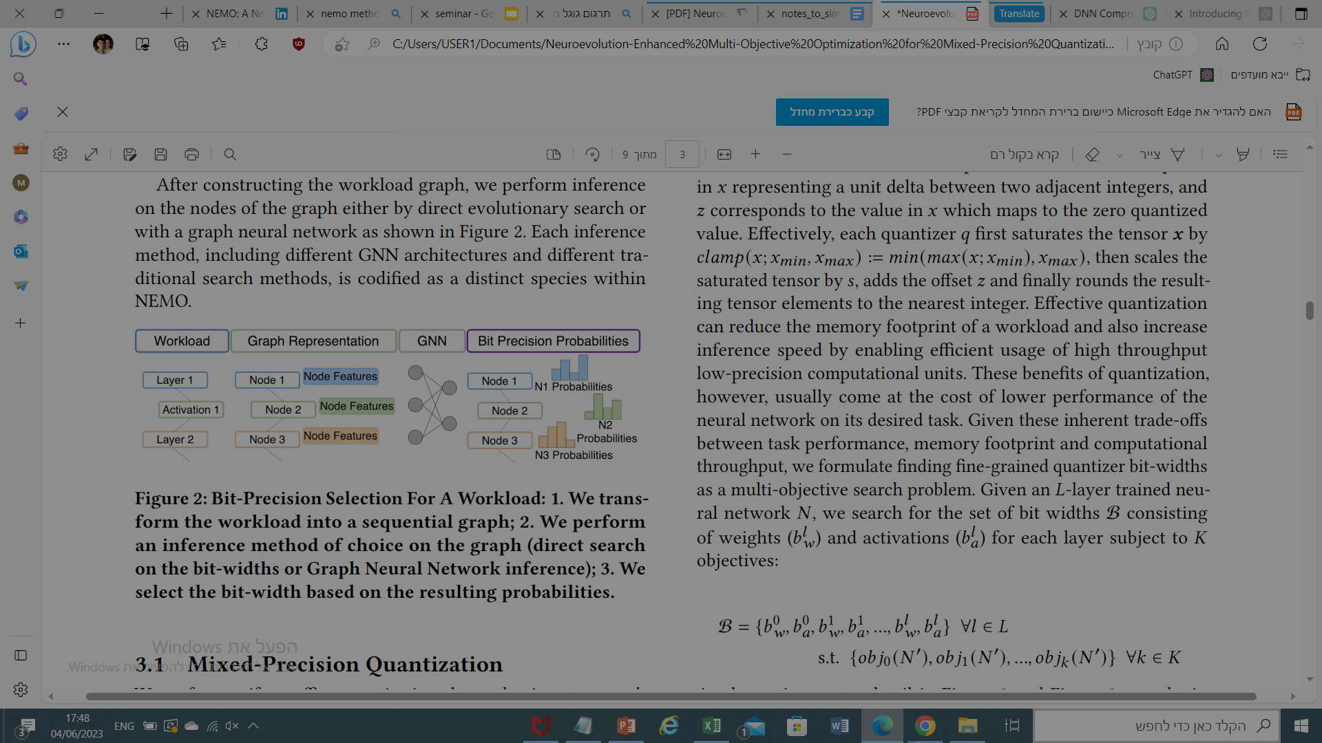
create a graph representation by declaring each quantizable operation in the workload as a node and build the edges by connecting the nodes sequentially
Notes:
amal

Slide 8
The node features of the graph representation consist of a concatenation of a one-hot encoding of the given operation and four general features associated with the described in detail in Appendix B.2.
Notes:
amal

Slide 9
After constructing the workload graph, we perform inference on the nodes of the graph either by direct evolutionary search or with a graph neural network
Notes:
mary

Slide 10
Each inference method, including different GNN architectures and different traditional search methods, is codified as a distinct species within NEMO.
We select the bit-width based on the resulting probabilities.
Notes:
mary

Slide 11
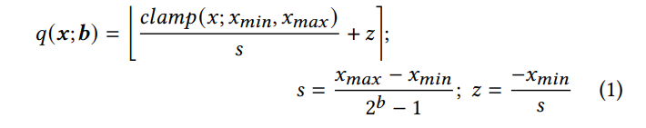
More about this method… Mixed-Precision Quantization
performing uniform affine quantization:
mapping the high-precision weight and activation tensors of a neural network to a fixed set of points determined by the quantization bit width.
This mapping is achieved using an affine function that includes scaling and offset parameters:
Notes:
mary -𝑞(𝒙; 𝒃): This function quantizes the input value 𝒙 using a quantization bit width 𝒃.
-𝑐𝑙𝑎𝑚𝑝(𝑥; 𝑥𝑚𝑖𝑛, 𝑥𝑚𝑎𝑥): This component clips the input value 𝑥 to the range between 𝑥𝑚𝑖𝑛 and 𝑥𝑚𝑎𝑥. It ensures that the input value falls within the desired dynamic range.
-𝑧: This represents the zero point used in quantization. It is calculated as -𝑥𝑚𝑖𝑛 divided by 𝑠.

Slide 12
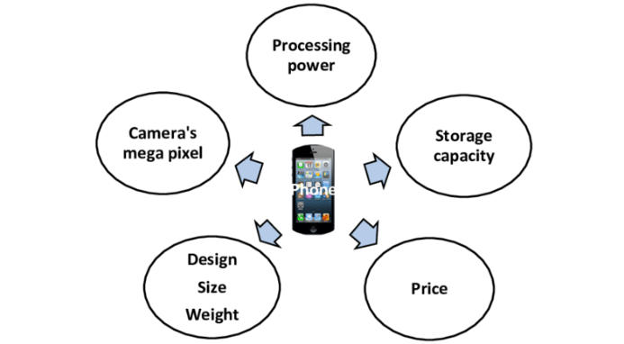
However
Effective quantization reduces memory footprint and improves inference speed
This usually comes at the cost of lower performance of the neural network on its desired task.
Thus
Trade-offs between task performance, memory usage, and computational efficiency are addressed by treating quantizer bit-width search as a multi-objective problem.
Notes:
Mary - Many situations that we encounter in our daily lives can surprisingly be expressed as multi-objective optimization problems. When we buy a new phone or laptop, we judge cost, performance, battery life, and many other factors at the same time. And almost always, it’s nearly impossible to find a product that has the best performance and battery life at the lowest cost. A laptop with the best performance and highest battery life often has the highest cost, while the cheapest one usually lags in the other factors. As such, we often end up deciding based on a set of options that we consider to be the best collection of solutions.

Slide 13
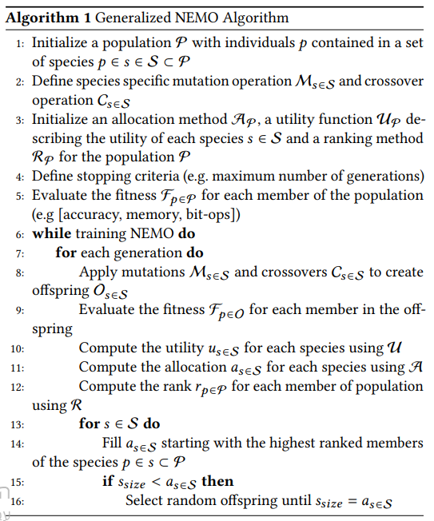
Algorithm 1 Generalized NEMO Algorithm
Notes:
amal

Slide 14
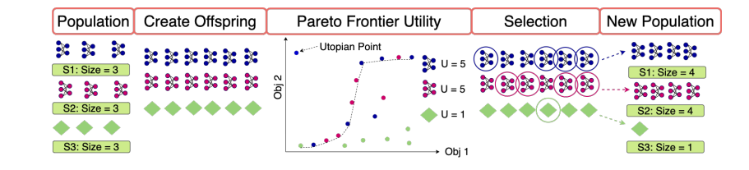
This algorithm represents the iterative process of evolution, where individuals are selected, mutated, and crossed over to create new offspring. The utility and allocation methods help manage the different species, and the ranking method guides the selection of individuals for the next generation. The process continues until the stopping criteria are met.
Notes:
amal

Slide 15
Search species:
Continuous Direct Search: Explores a range of bit-width precision.
Floor-Rounding Direct Search: Chooses integer bit-widths biased towards lower values.
Sequential Graph - GCN: Optimizes graph neural networks using specialized techniques.
Modified Graph U-Net :with graph-attention layers for sequential graph processing, utilizing SSNE for mutation and crossover based on GNN logits.
Each species has its own search strategy for optimizing neural network configurations.
Notes:
Mary- in two words

Slide 16
EXPERIMENTS & RESULTS
In our experiments, we use different ImageNet workloads
(MobileNet-V2, ResNet50, ResNeXt-101-32x8d)
with pre-trained models from Torch Vision.
We apply NNCF for automatic quantization layer insertion, specifically using asymmetric affine quantization.
We extract NNCF representation attributes as graph features and perform multi-objective optimization using NEMO. Our objectives include maximizing task performance (Top5 Accuracy), minimizing memory compression (Model-Ratio), and minimizing compute compression (Bit-Operation Ratio).
We evaluate on a subset of the ImageNet training data for faster evaluations and report results in Top1 accuracy.
Notes:
mary

Slide 17
Multi-Objective Pareto Optimal Sets
Experiments were conducted on different models using the ImageNet dataset. quantized the models to reduce memory and computation requirements while maintaining performance. We observed that there are specific points where quantization significantly affects performance.
For memory compression, MobileNet-V2 has a larger performance drop but uses less memory compared to other models like ResNet50 and ResNeXt-101-32x8d. For compute compression, each model has a threshold where performance degrades. MobileNet-V2 has a lower threshold due to its compressed architecture.
The results show that there are trade-offs between performance, memory usage, and computation. Different models have different strengths depending on the specific needs of the application.
Notes:
marry

Slide 18
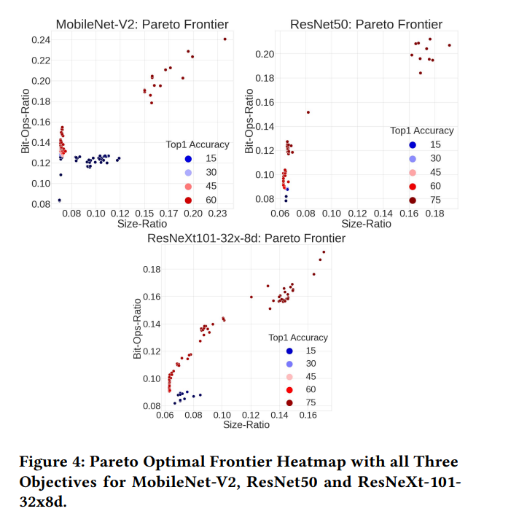
Multi-Objective Pareto Optimal Sets
Notes:
mary

Slide 19
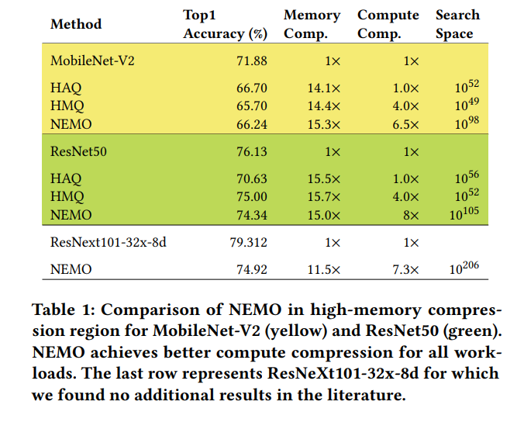
NEMO Search Analysis
Notes:
mary

Slide 20
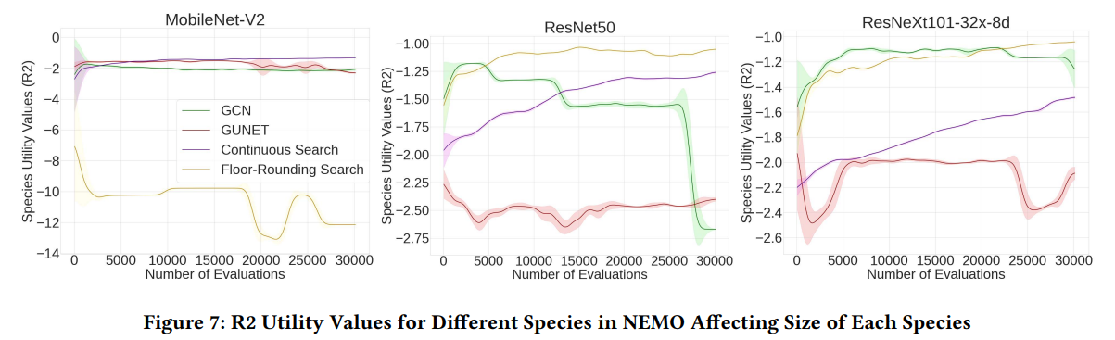
Notes:
amal

Slide 21
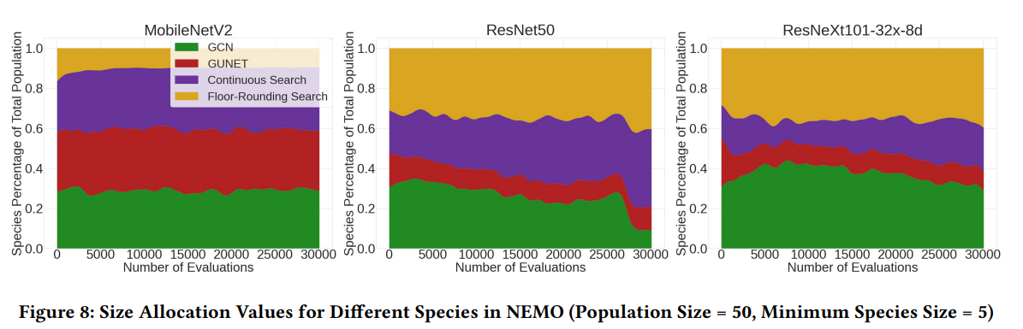
Notes:
amal

Slide 22
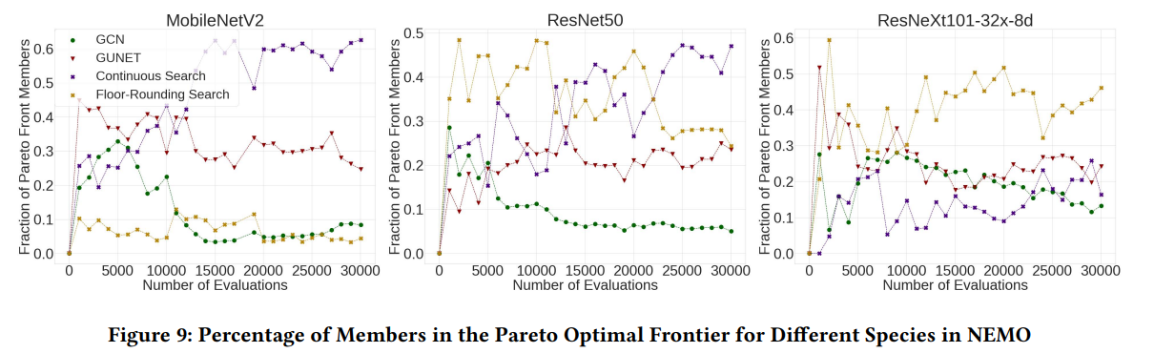
Notes:
amal

Slide 23
In Conclusion
The NEMO approach for mixed-precision quantization is competitive and sometimes superior to other methods like HAQ and HMQ. NEMO achieves this without fine-tuning workload parameters and operates in larger search spaces, demonstrating its flexibility. The results show that NEMO has the potential to deliver relevant solutions for real-world engineering problems by representing different problem formulations with distinct species.
Notes:
amal

